Slide 1
Predicting House Prices Using Machine Learning
Final Project
JAWAHARLAL NEHRU N
(2021503313)

Slide 2


AGENDA
Problem Statement
Project Overview
End Users
Solution and Value Proposition
Modeling
Results
3/21/2024 Annual Review

Slide 3

PROBLEM STATEMENT
Predicting house prices is challenging due to the city's diverse real estate market, with variations in prices based on location, amenities, and other factors. Accurate price predictions are crucial for buyers, sellers, and real estate agents to make informed decisions and negotiate effectively.

Slide 4

PROJECT OVERVIEW
The project aims to develop a model that can predict house prices using a dataset containing information about various houses in the city. The dataset includes features such as location, size, number of bedrooms, and amenities. The model will be trained using linear regression to predict house prices based on these features.

Slide 5
WHO ARE THE END USERS?
The target audience for the price predictions includes prospective home buyers, real estate investors, and sellers. These stakeholders can benefit from the model's accurate price predictions to make informed decisions about buying, selling, or investing in properties.

Slide 6

YOUR SOLUTION AND ITS VALUE PROPOSITION
Our model offers a solution to the challenges of predicting house prices by leveraging machine learning techniques. The model analyzes the dataset to identify patterns and trends that affect house prices, providing users with reinformed decisions and potentially save time and money in the real estate market.Eliable price predictions.

Slide 7

THE WOW IN YOUR SOLUTION
One of the key features of our solution is its ability to handle the diverse real estate market. The model can analyze a wide range of features, including location, size to provide accurate price predictions. Additionally, the model is user-friendly and can be easily accessed and utilized by stakeholders in the real estate market.
3/21/2024 Annual Review
7

Slide 8
MODELLING
The linear regression model used in this project is a statistical technique for predicting house prices based on the relationship between the independent variables (features) and the dependent variable (house price). The model is trained using the dataset to learn this relationship and can then be used to make predictions on new data.
8

Slide 9
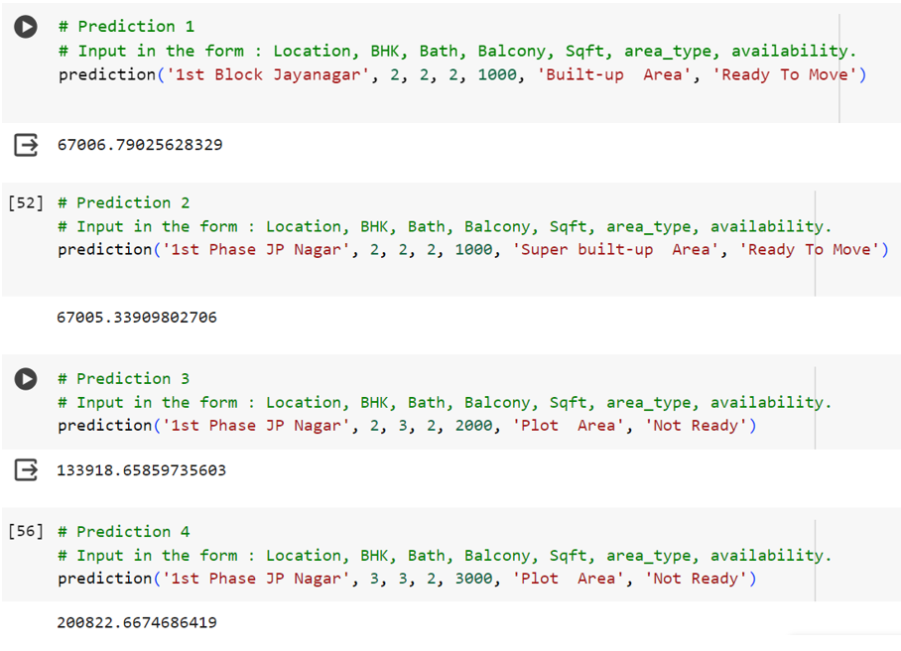
RESULTS
9

